Slide 1
Analysis of Stroke Dataset and Building Logistic Regression and K Means Clustering Models
By Ameya Rajesh Kelaskar
School of Information Studies, Syracuse University

Slide 2


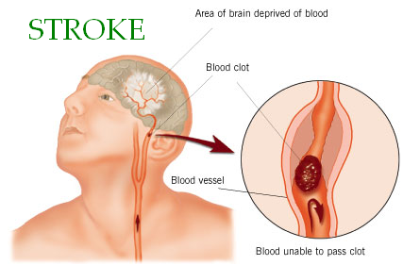

Overview
Stroke is a leading cause of death in the United States and is a major cause of serious disability for adults.
About 795,000 people in the United States have a stroke each year.
Therefore, I decided to analyze the stroke dataset and determine whether certain factors can be causes of stroke.
This will help us determine if it is possible to predict and even prevent stroke.

Slide 3
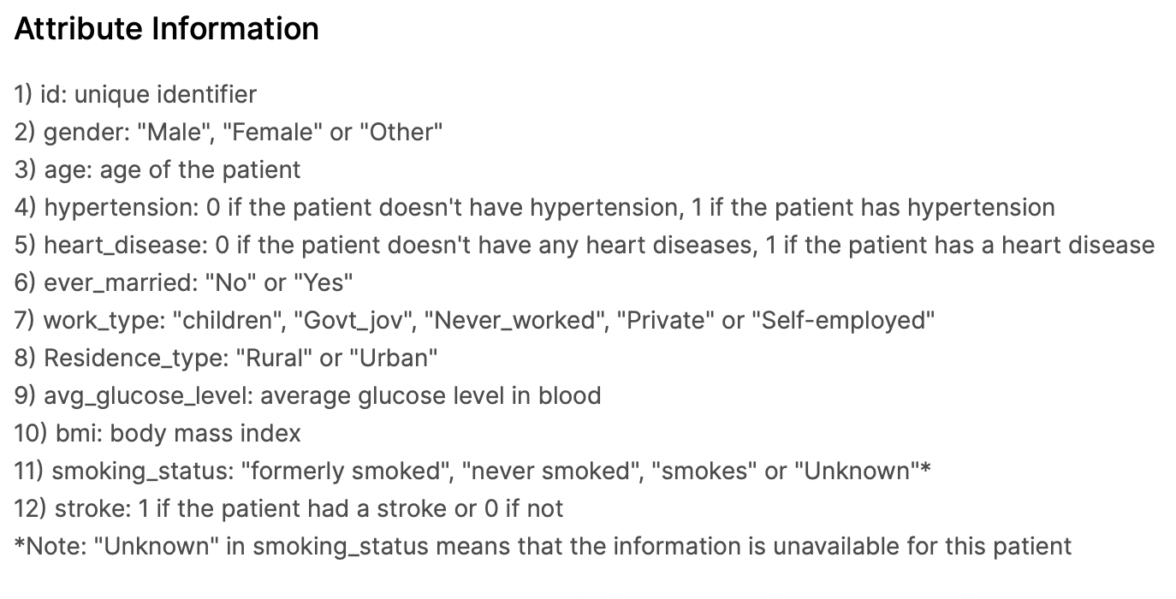
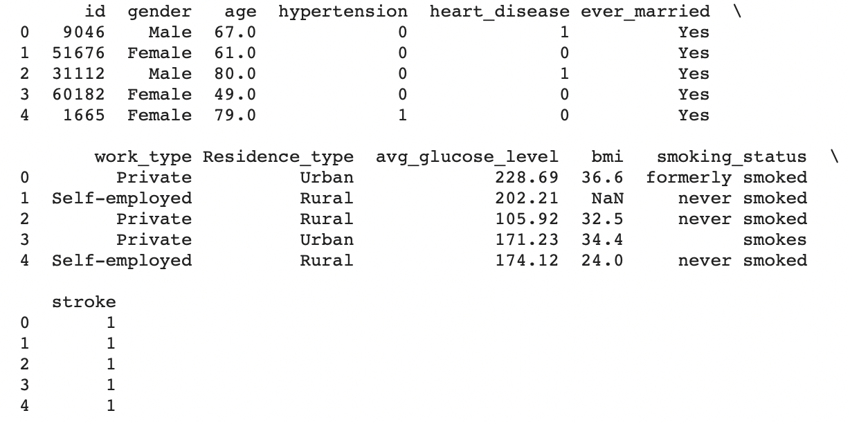
Data
I have used the Stroke Prediction Dataset from Kaggle: https://www.kaggle.com/fedesoriano/stroke-prediction-dataset
It has 5110 rows and 11 columns

Slide 4
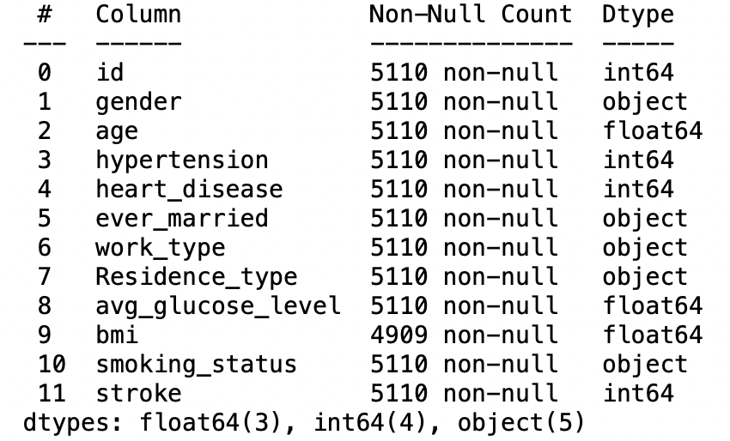
Data Preprocessing
After checking out the data with df.info(), we realize that it is a decent dataset.
Only the BMI column has nulls.
The object type features need to be converted to categorical types.

Slide 5
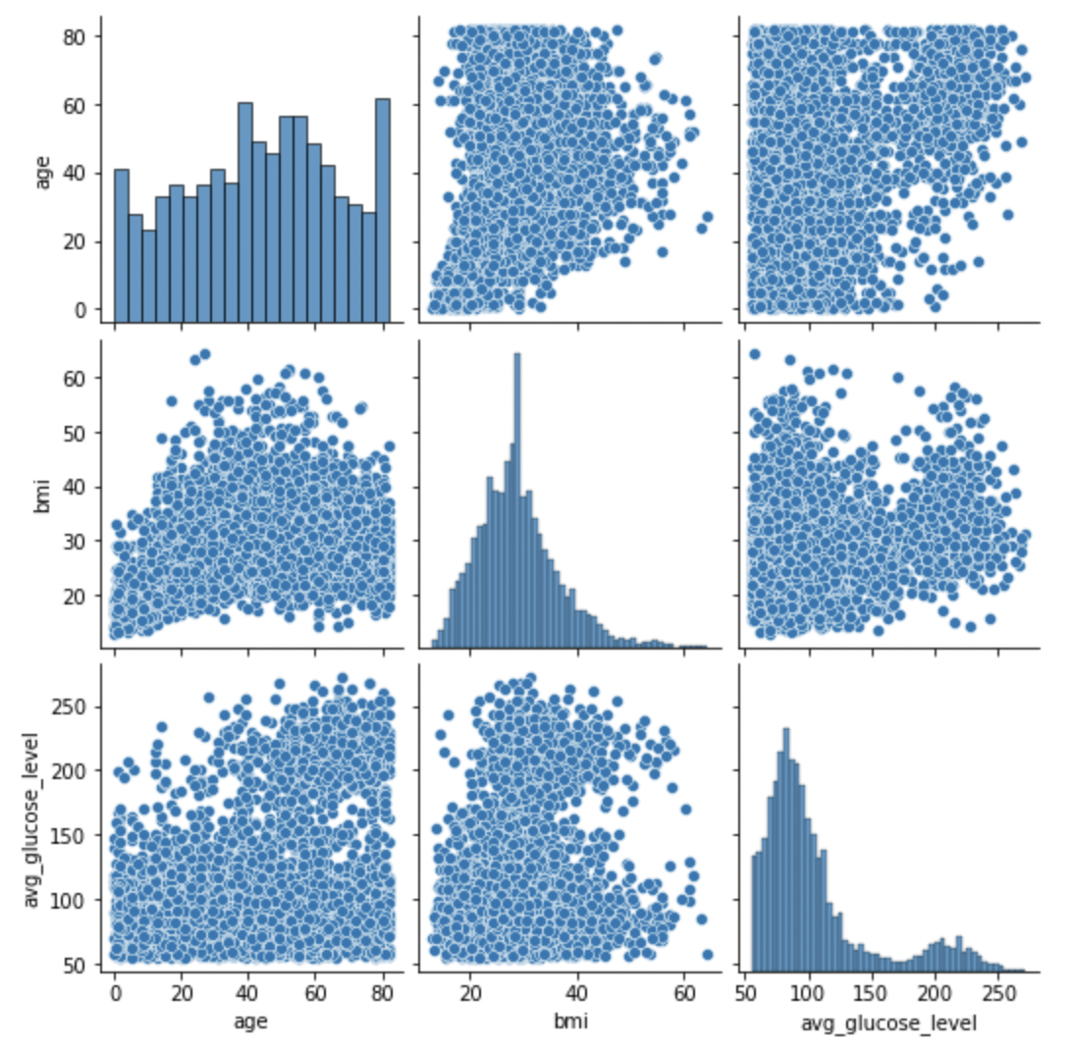
Visualization
First, I have plotted seaborn pairplots to check for patterns between the numerical attributes.

Slide 6
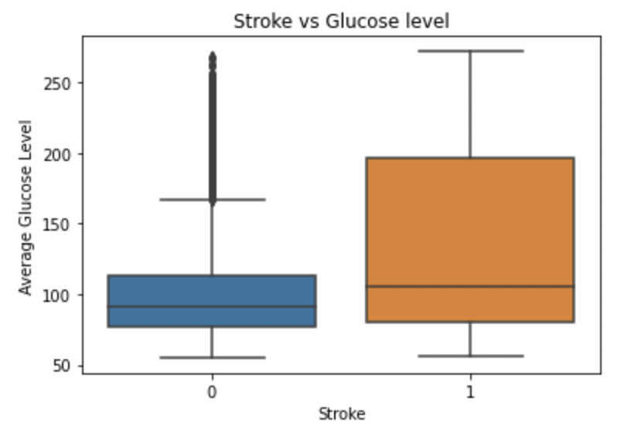
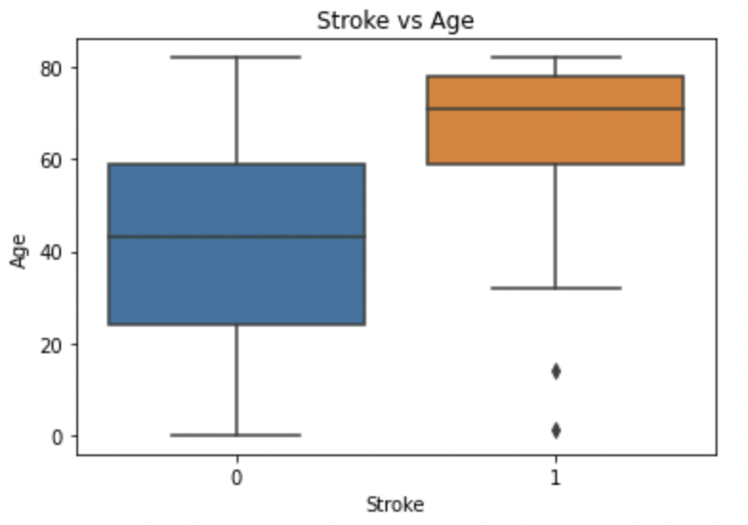
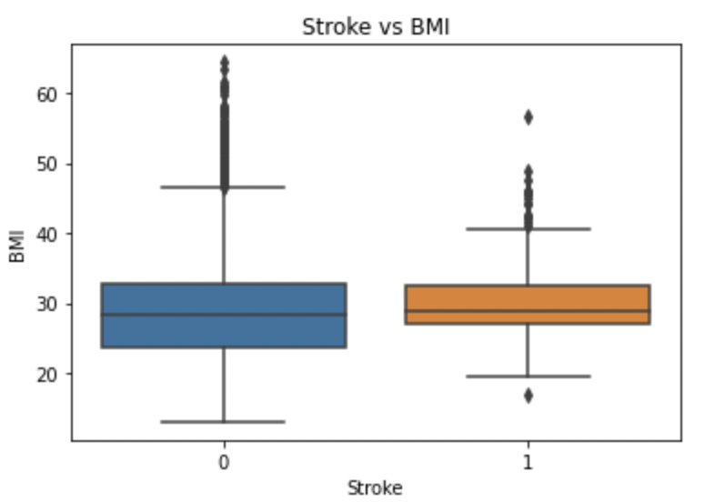
Visualization
By plotting box-plots of glucose
Levels, age and BMI against the
Stroke Variable, we realize that
These factors are correlated to it.

Slide 7
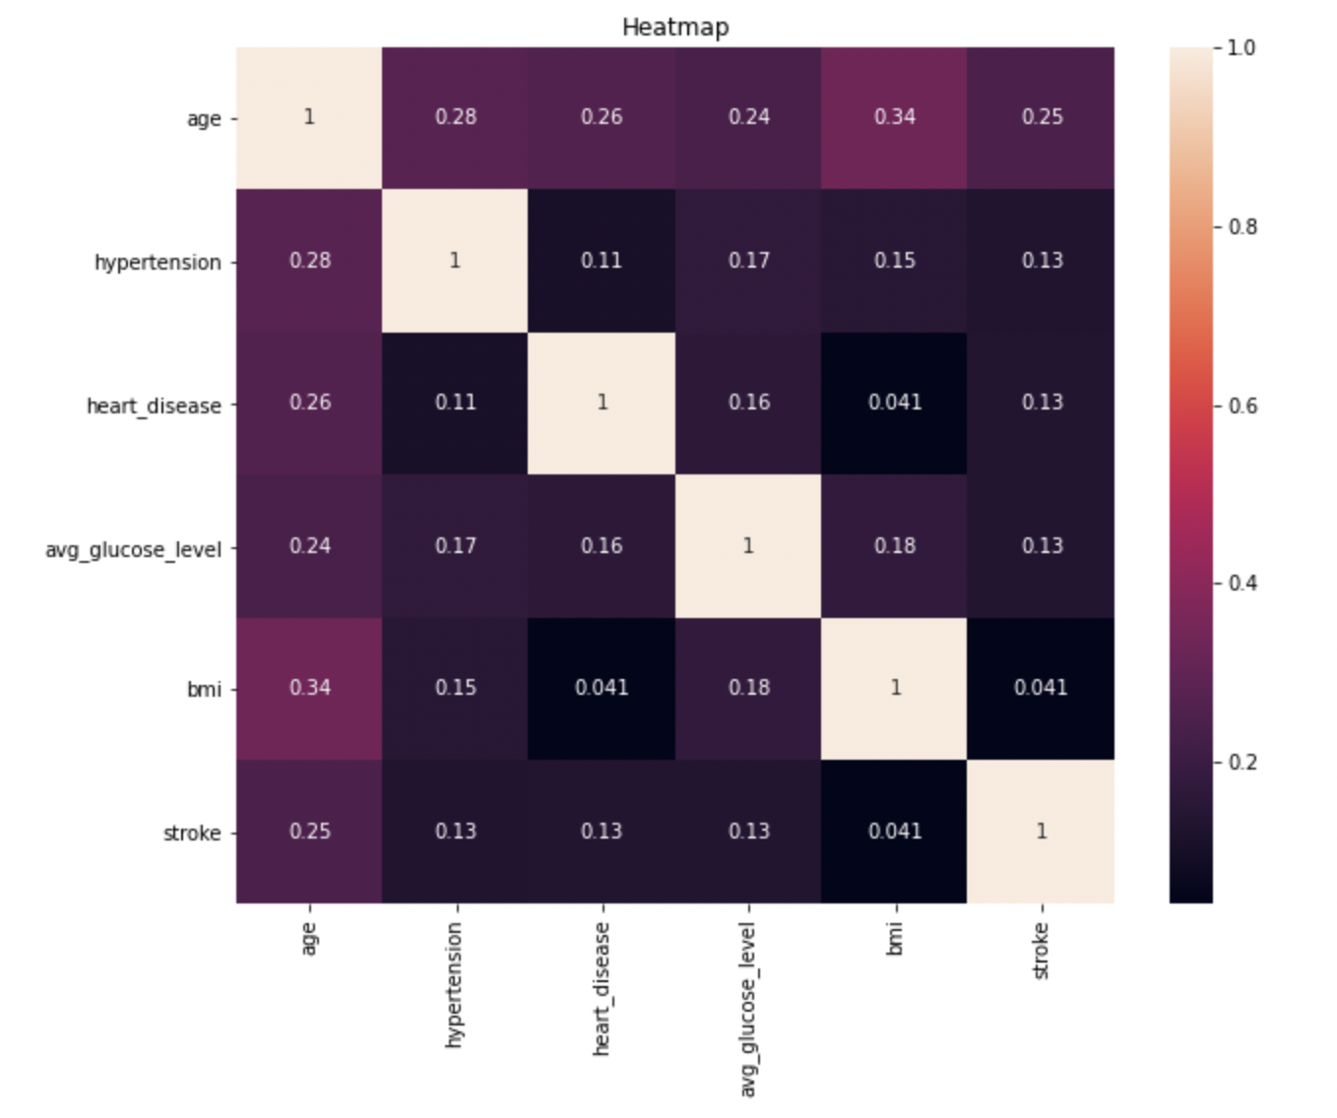
Visualization
Heatmap helps us determind the correlation between various attributes

Slide 8
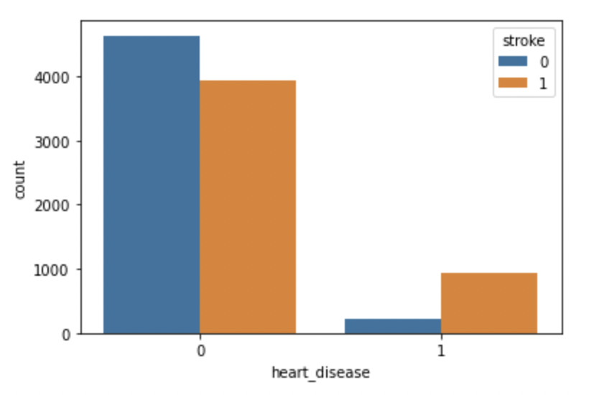
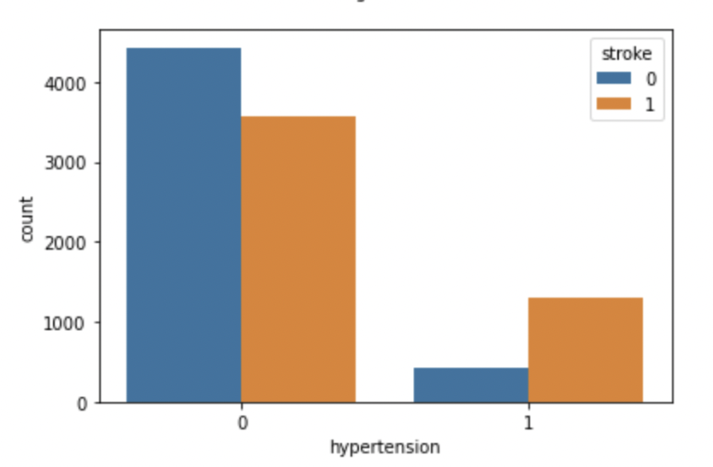
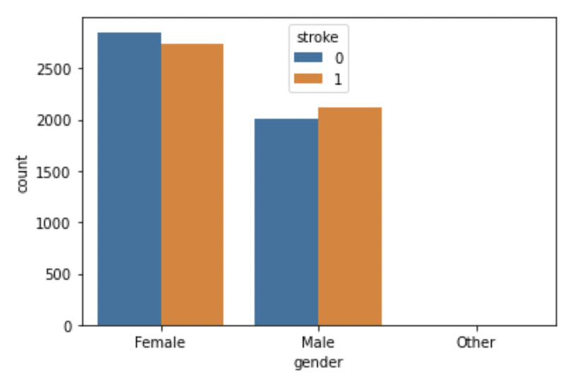
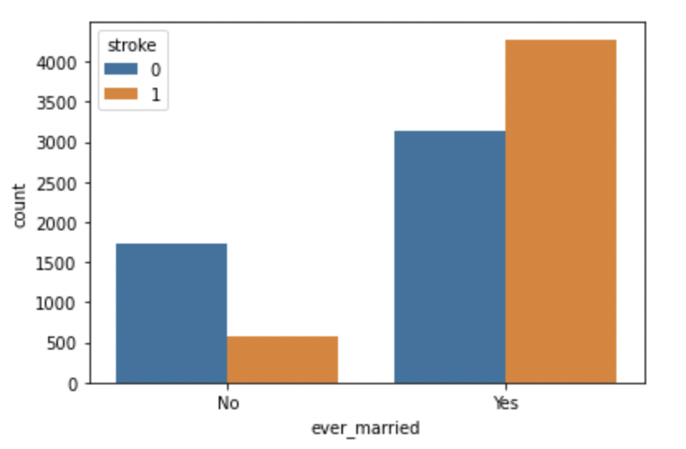
Visualization
Further, we proceed to determine correlation between categorical variables and stroke.
z

Slide 9
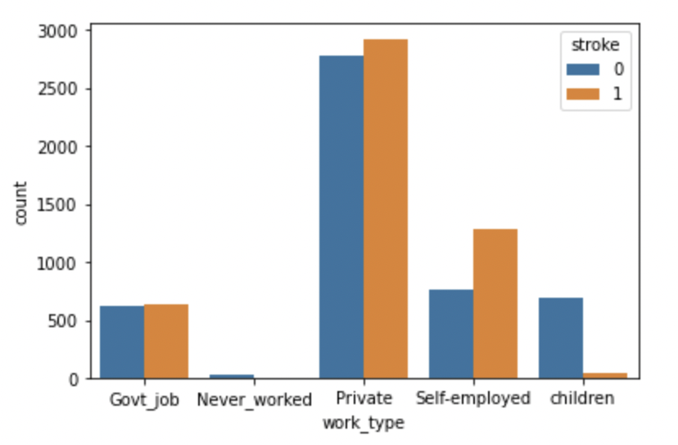
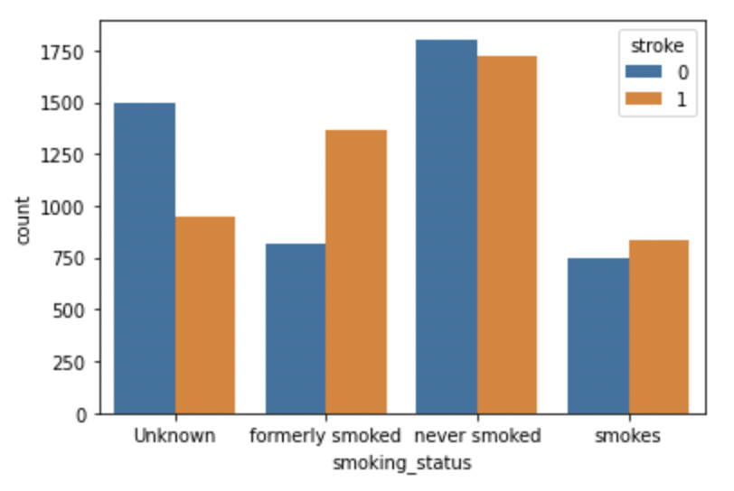
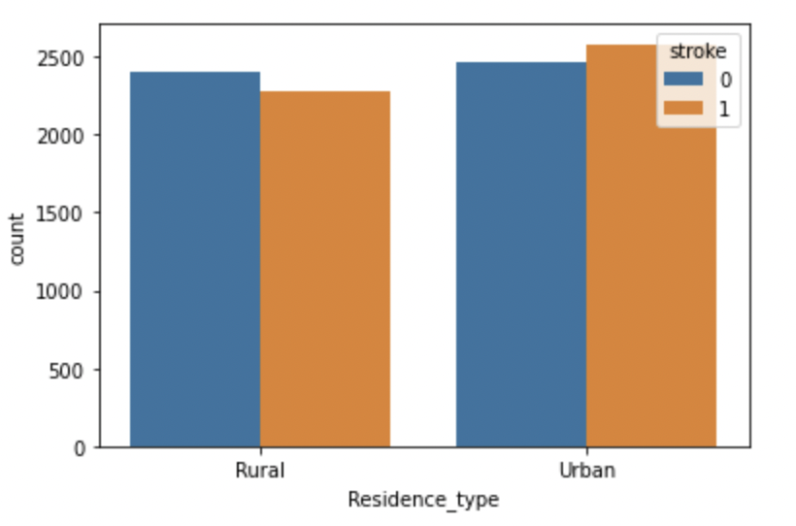
Visualization
More plots of categorical variables
z

Slide 10
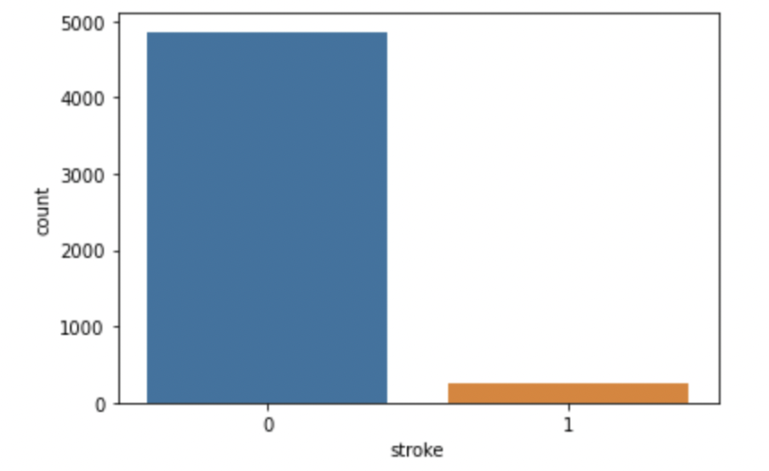
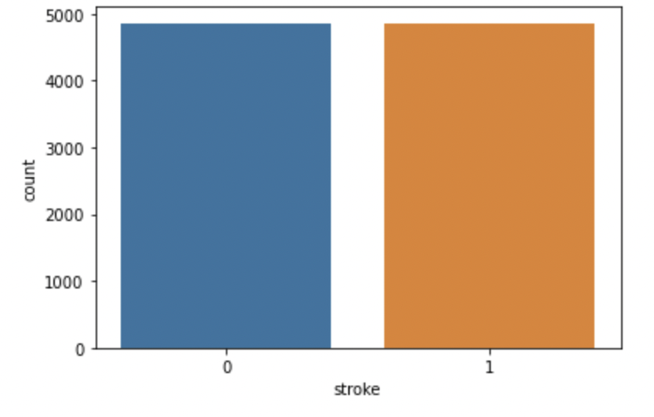
Balancing the stroke variable
I used oversampling to balance the stroke variable

Slide 11
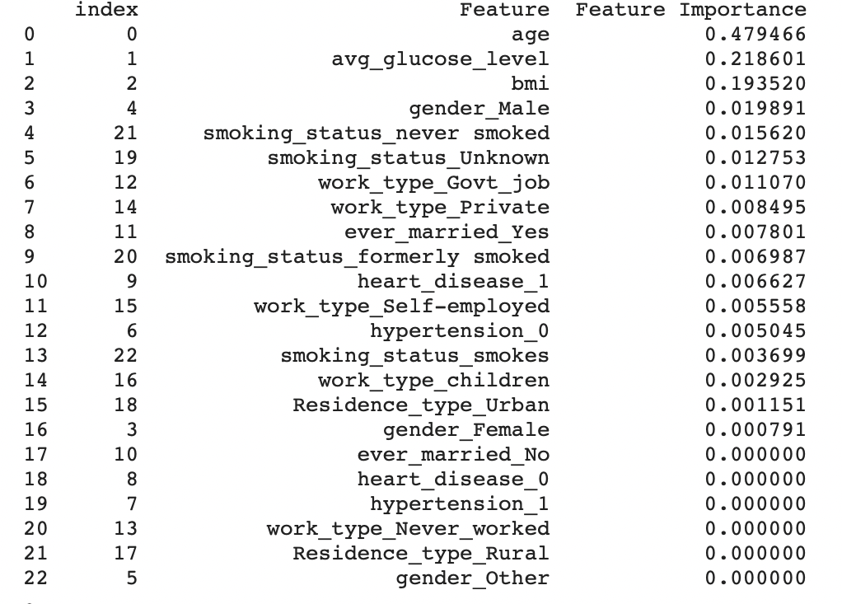
Feature selection
I decided to eliminate all features that have zero importance, as they will not be of any use in the modelling process.

Slide 12
Splitting the data before training
I separated the data into X (for independent variables) and y (for the dependent variable).
For creating the training-test split, I used the ‘train_test_split’ feature in sklearn. My training data was 80%, testing data was 20% and the Hold-out sample was 10%.
This hold-out sample is data that will be unseen by the model, which we will use to determine the model performance at the end.

Slide 13
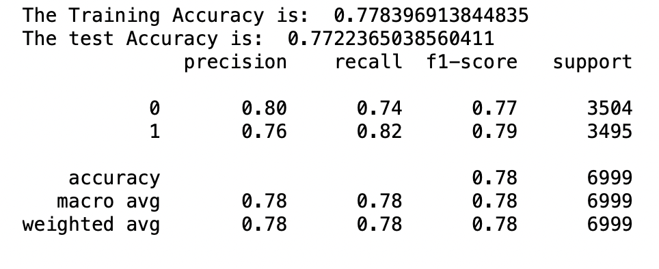
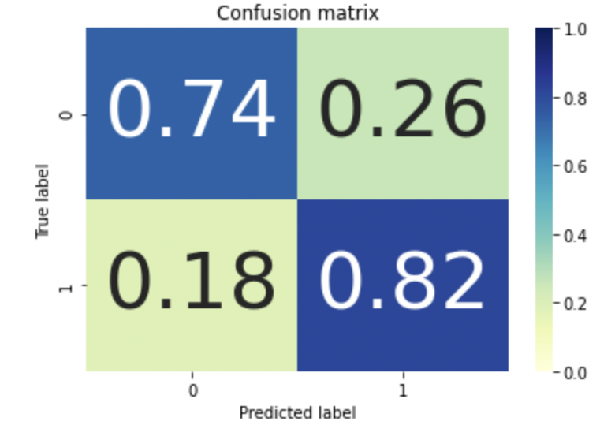
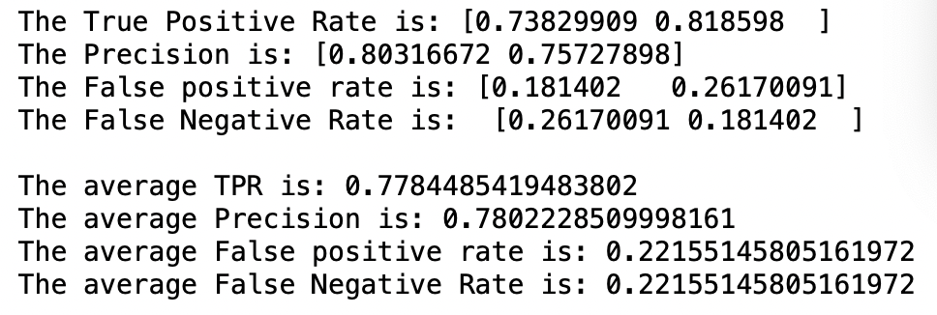
Logistic Regression
The logistic regression evaluation metrics indicate that the model is good.

Slide 14
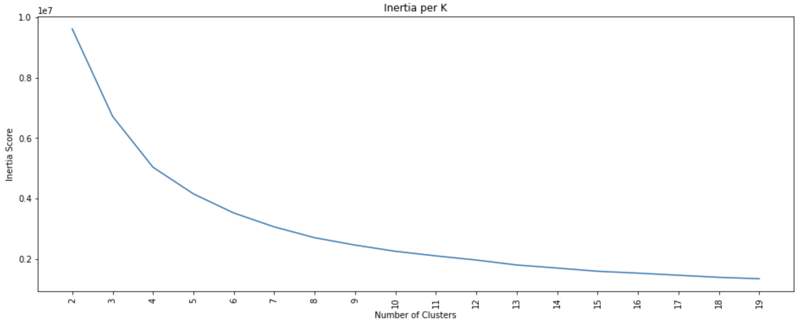
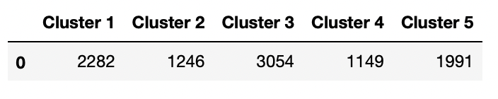
K-Means Clustering
Using the elbow method, I determined ideal K to be 5
I obtained 5 clusters as shown.

Slide 15
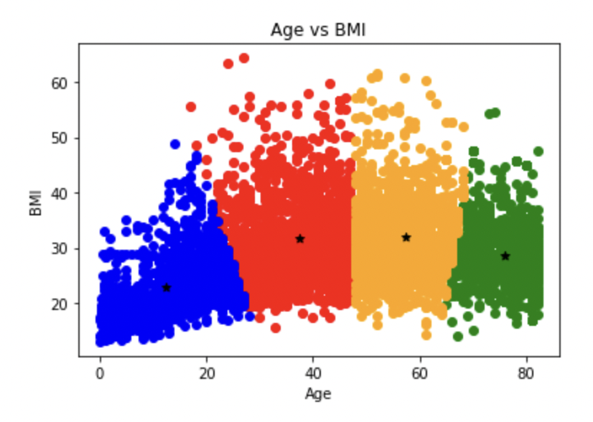
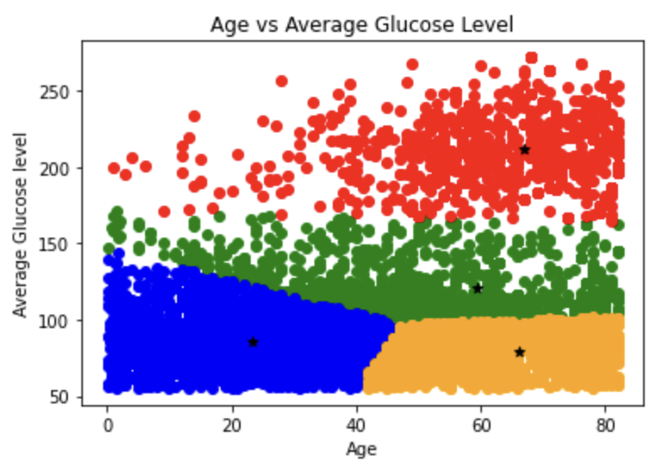
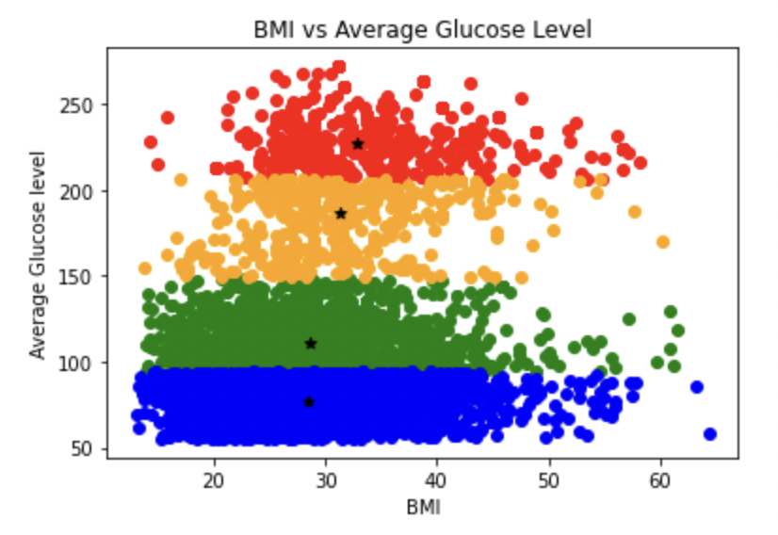
K- Means clustering
Using only two variables per model, I was able to visualize some patterns using the clusters.

Slide 16
Conclusion
From the logistic regression model and K-means clustering, I was able to determine the link between the features and to determine the importance of each feature with regards to determining the possibility of stroke.
In conclusion, it is safe to ascertain that stroke can be predicted if we are given the features assessed. Moreover, stroke can also be prevented by controlling factors like average glucose levels and BMI in patients

